Slide 1
UMET9U-30-1- Professional Skills for Banking and Finance Lecture 8
Presented by
Reinhold Heinlein
November 2025

Slide 2
Lecture content
Descriptive statistics
Mean, median, mode
Variance, standard deviation
Coefficient of variation

Slide 3
Introduction
Descriptive statistics are used to summarise information which would otherwise be too complex to take in.
To summarise we use:
Measures of location or central tendency (mean, median, mode)
Measures of dispersion (variance, standard deviation)
Measures of skewness
Measures of kurtosis
(These measures are called moments of a distribution. We will focus on the first two moments.)

Slide 4

Mean of a population $x_{1},x_{2},x_{3}, …, x_{N}$
$$μ=\frac{\sum_{i=1}^{N}{x_{i}}}{N}$$
Mean of a sample $x_{1},x_{2},x_{3}, …, x_{n}$
$$\overline{x}=\frac{\sum_{i=1}^{n}{x_{i}}}{n}$$

Slide 5

How to find the mean for this dataset?
17, 17, 18, 18, 18, 19, 19, 20, 21, 21
$$\overline{x}=\frac{\sum_{i=1}^{n}{x_{i}}}{n}=\frac{(17+17+…+21)}{10}=18.8$$

Slide 6
The median is the ‘number in the middle’ once the data have been put in rank order.
If the sample size is odd:
17, 17, 18, 18, 18, 19, 19, 20, 21, 21 and 22 (11 values)
Median = 19
If the sample size is even:
17, 17, 18, 18, 18, 19, 19, 20, 21, 21 (10 values)
Median is the average of the 5th and the 6th value.
Median = 18.5

Slide 7
The mode is the most frequent value.
17, 17, 18, 18, 18, 19, 19, 20, 21, 21
Mode = 18
In this sample:
Mean = 18.8
Median = 18.5
Mode = 18

Slide 8
The weighted mean is similar to the arithmetic mean, but more weight is placed on some observations than others.
Example: Calculating the average expenditure on a pupil by an education authority would have to take into account the greater numbers in primary and secondary education than post 16 education.
Table 1: Cost per pupil in different types of schools
 | Primary | Secondary | Post-16
Unit costs (£) | 5,200 | 7,400 | 8,750

Slide 9
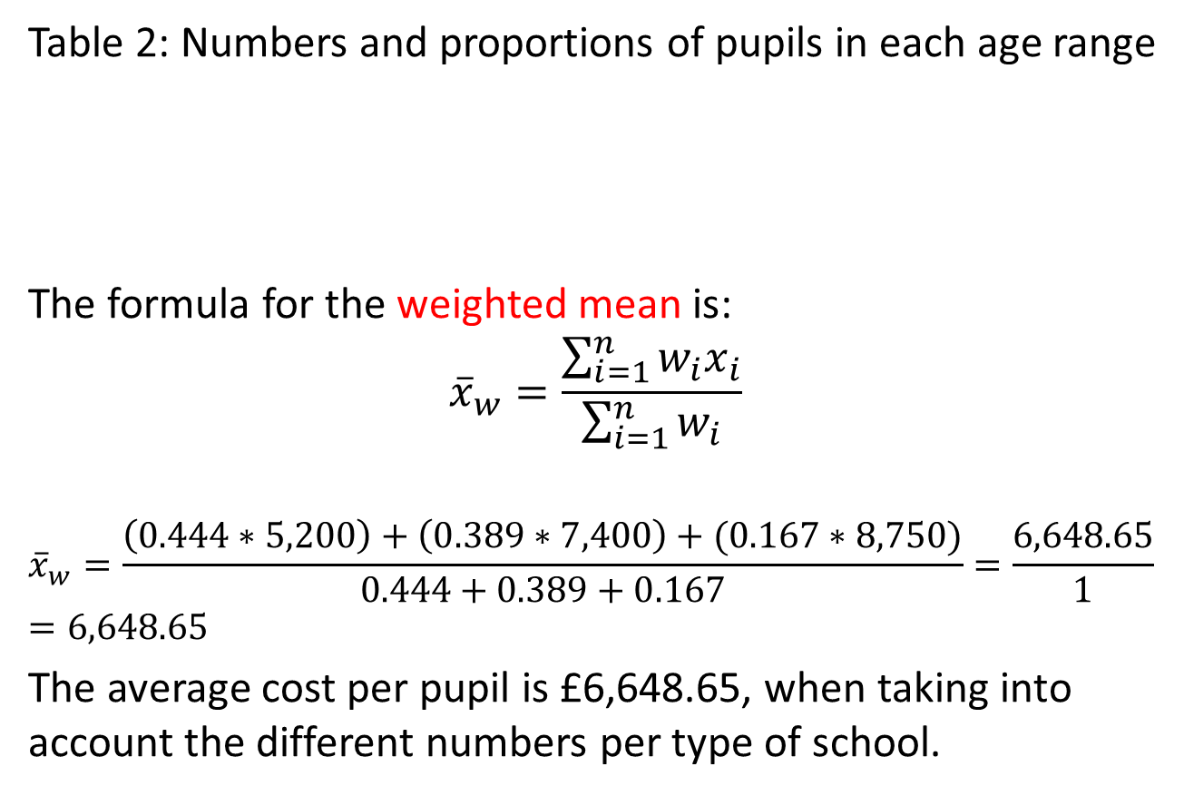
Table 2: Numbers and proportions of pupils in each age range
The formula for the weighted mean is:
$${\overline{x}}_{w}=\frac{\sum_{i=1}^{n}{w_{i}x_{i}}}{\sum_{i=1}^{n}{w_{i}}}$$
$${\overline{x}}_{w}=\frac{\left(0.444∗5,200\right)+\left(0.389∗7,400\right)+(0.167∗8,750)}{0.444+0.389+0.167}=\frac{6,648.65}{1}=6,648.65$$
The average cost per pupil is £6,648.65, when taking into account the different numbers per type of school.
 | Primary | Secondary | Post-16 | Total
Numbers | 8,000 | 7,000 | 3,000 | 18,000
Proportions | 44.4% | 38.9% | 16.7%

Slide 10
Measures of dispersion
Range
Variance
Standard deviation
Coefficient of variation

Slide 11
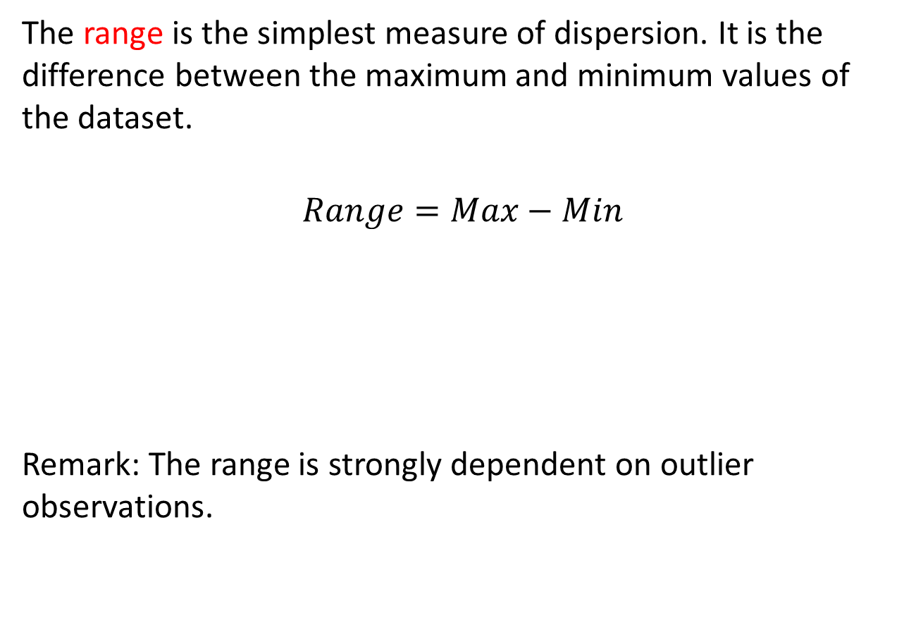
The range is the simplest measure of dispersion. It is the difference between the maximum and minimum values of the dataset.
$$Range=Max−Min$$
Remark: The range is strongly dependent on outlier observations.

Slide 12
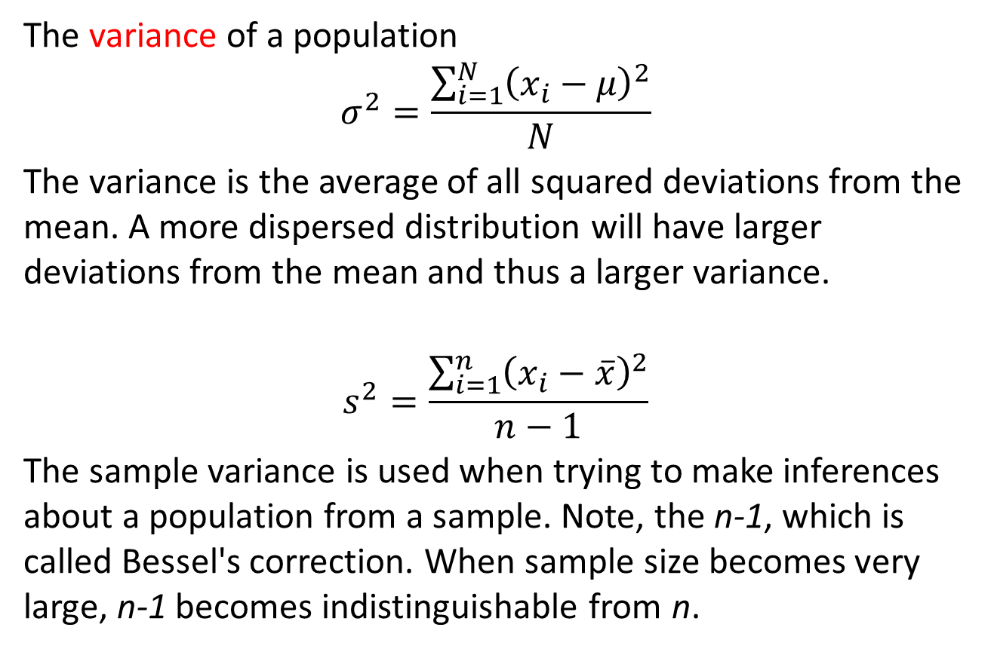
The variance of a population
$$σ^{2}=\frac{\sum_{i=1}^{N}{{\left(x_{i}−μ\right)}^{2}}}{N}$$
The variance is the average of all squared deviations from the mean. A more dispersed distribution will have larger deviations from the mean and thus a larger variance.
$$s^{2}=\frac{\sum_{i=1}^{n}{{\left(x_{i}−\overline{x}\right)}^{2}}}{n−1}$$
The sample variance is used when trying to make inferences about a population from a sample. Note, the n-1, which is called Bessel's correction. When sample size becomes very large, n-1 becomes indistinguishable from n.

Slide 13
A small variance in pink and a large variance in dark blue.

Slide 14
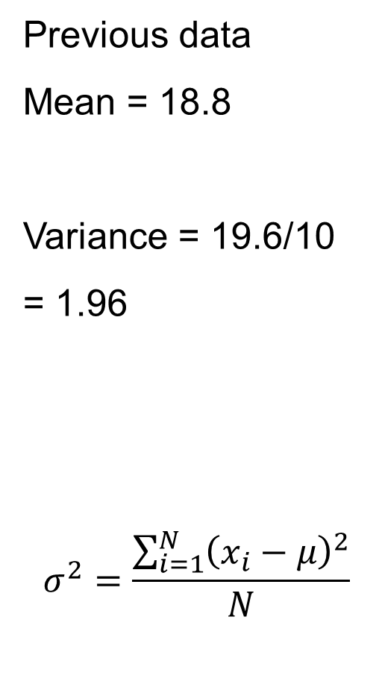
data | data-mean | (data-mean)²
17 | -1.8 | 3.24
17 | -1.8 | 3.24
18 | -0.8 | 0.64
18 | -0.8 | 0.64
18 | -0.8 | 0.64
19 | 0.2 | 0.04
19 | 0.2 | 0.04
20 | 1.2 | 1.44
21 | 2.2 | 4.84
21 | 2.2 | 4.84
188 |  | 19.6
Previous data
Mean = 18.8
Variance = 19.6/10
= 1.96
$$σ^{2}=\frac{\sum_{i=1}^{N}{{\left(x_{i}−μ\right)}^{2}}}{N}$$

Slide 15
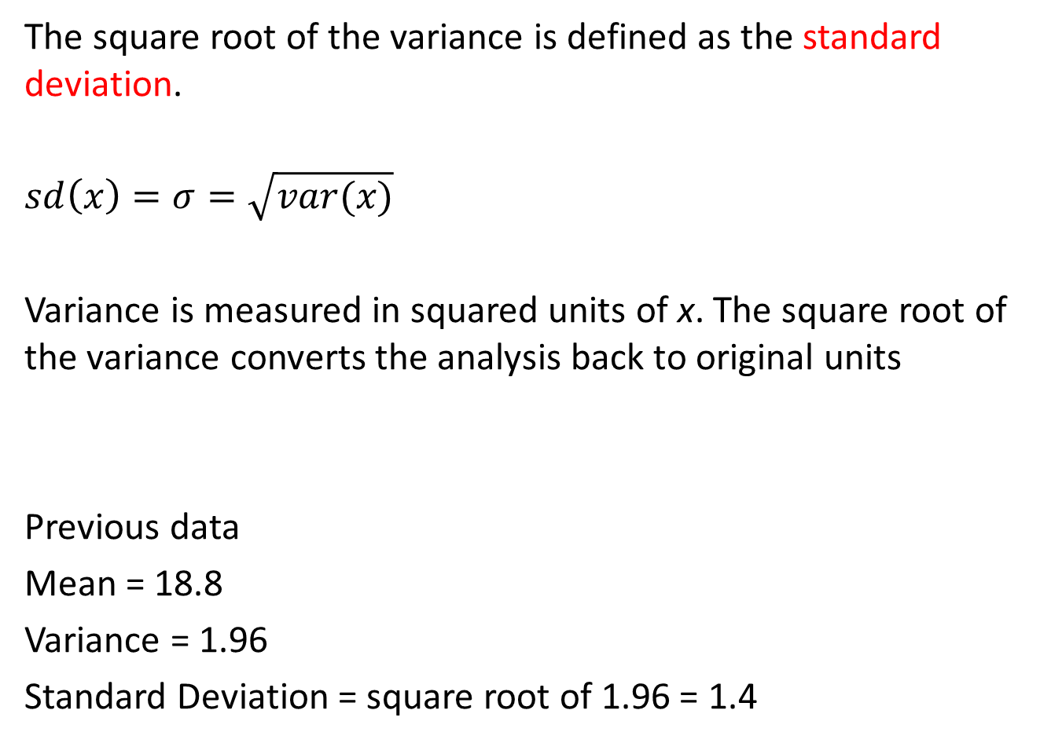
The square root of the variance is defined as the standard deviation.
$$sd\left(x\right)=σ=\sqrt{var(x)}$$
Variance is measured in squared units of x. The square root of the variance converts the analysis back to original units
Previous data
Mean = 18.8
Variance = 1.96
Standard Deviation = square root of 1.96 = 1.4

Slide 16
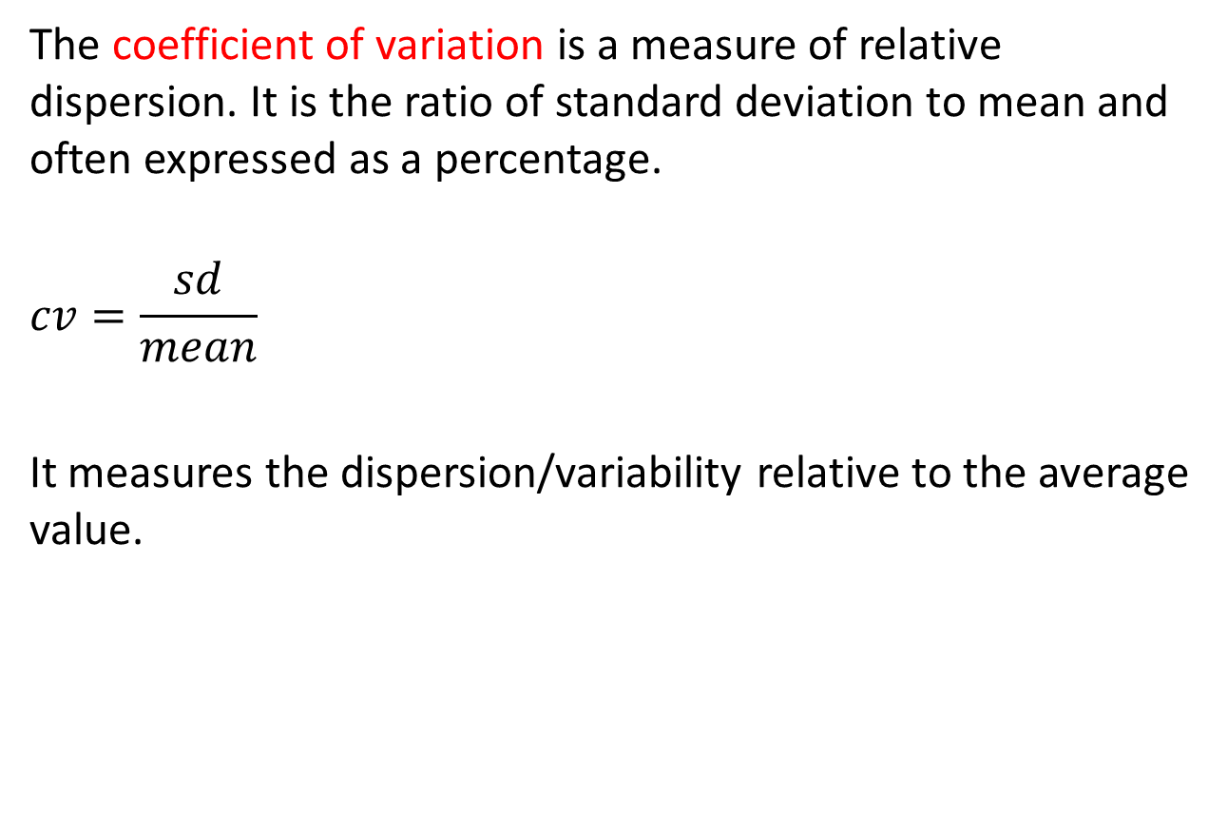
The coefficient of variation is a measure of relative dispersion. It is the ratio of standard deviation to mean and often expressed as a percentage.
$$cv=\frac{sd}{mean}$$
It measures the dispersion/variability relative to the average value.

Slide 17
Example:
Over the last 6 months, the average price of Internet based shares was £5.80 with a SD of £1.50. Manufacturing share prices were £3.50 on average with an SD of £0.80. Which shares had the highest relative variability?
Internet
cv = 1.50/5.80 = 0.2586 = 25.86%
Manufacturing
cv = 0.80/3.50 = 0.2285 = 22.85%
Internet shares have a higher relative variability we might infer a riskier investment.

Slide 18
Next Lecture
Graphical analysis
Bar chart, Pie chart, Line graph
Histogram
Ogive (cumulative frequency plot)
Box plot

